Slide 1
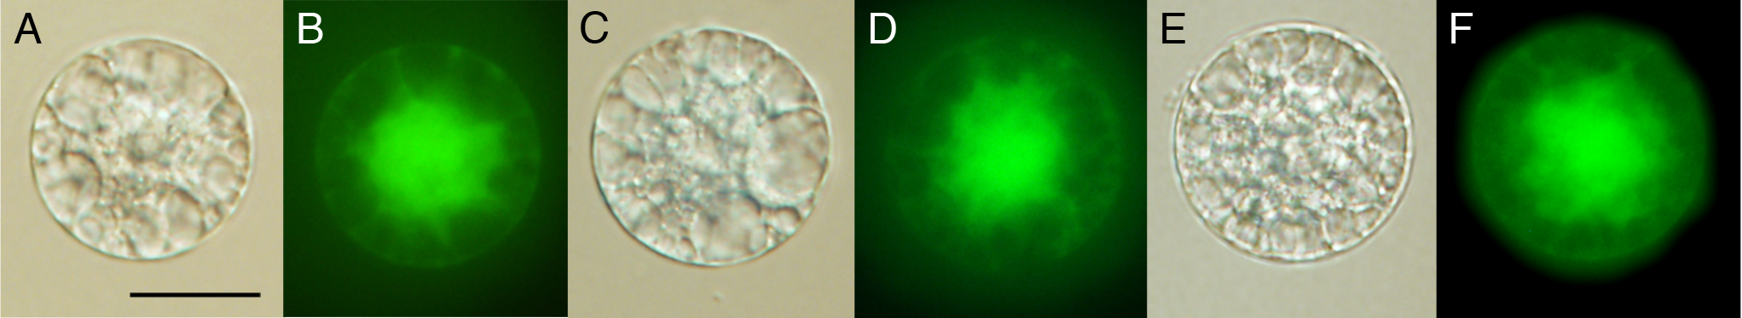

Gametes to Zygotes to Self-Cloning Plants
Venkatesan Sundaresan
UC Davis
sundar@ucdavis.edu
https://sundarlab.weebly.com/

Slide 2

Fertilization in Flowering Plants
♂ Gametophyte
(Pollen Grain)
Stigma
♀ Gametophyte
Ovules
(Embryo Sac)
Pollen Tube
enters Embryo
sac

Slide 3
Double Fertilization
Discharge of Two Sperm Cells from Pollen Tube
Fusion of Sperm cell 1N + Egg cell 1N = Zygote 2N
Fusion of Sperm cell 1N + Central Cell 2N = Endosperm3N
Central Cell Nucleus
2N
Egg Cell Nucleus
Sperm
Cells
1N
1N
Pollen Tube

Slide 4
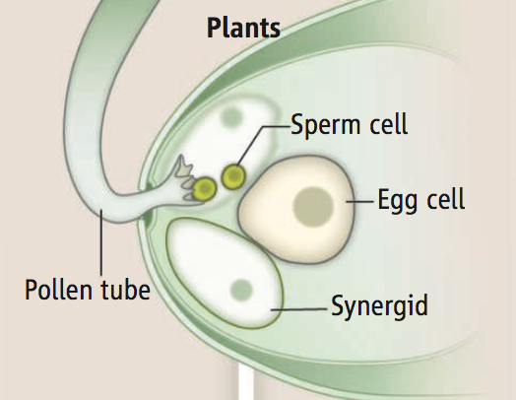
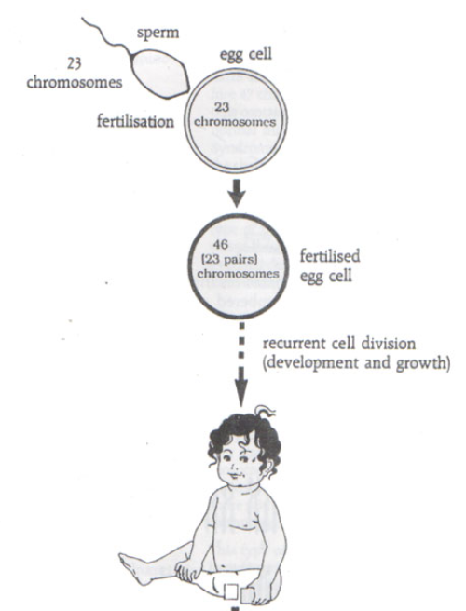
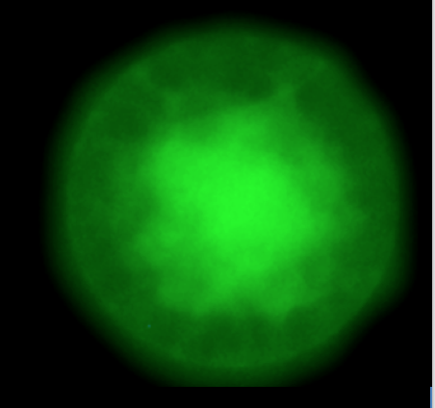
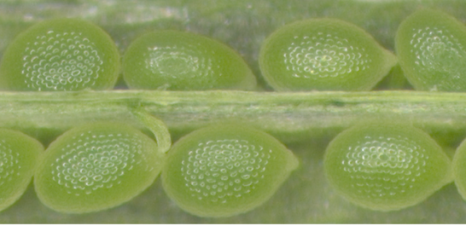
Fertilization -> Embryogenesis
Sperm cell + Egg cell
Zygote
Embryo

Slide 5
Fertilization -> Embryogenesis
Fusion of two terminally differentiated cells:
Egg cell + Sperm cell
Product of fusion is the Zygote
Zygote is Totipotent
→ Re-programming after fusion of nuclei
How do the male and female genomes participate in this re-programming?

Slide 6
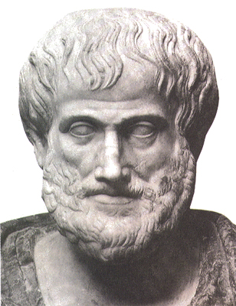
What are the Parental contributions to Zygotic development?
Egg Cell + Sperm Cell = Zygote (Totipotent)
Aristotle (~350 BC):
Mother provides “Matter”
Father provides “Form”
An offspring is generated when Matter (contributed by the mother) combines with Form (contributed by the father)

Slide 7
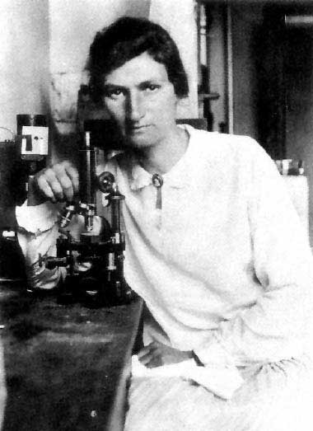
What are the Parental contributions to Zygotic development?
Egg Cell + Sperm Cell = Zygote (Totipotent)
Ethel Harvey (1937):
Experiments with Sea Urchins led her to conclude:
Early embryogenesis depends only upon Maternally deposited factors
Generally true for all animals

Slide 8
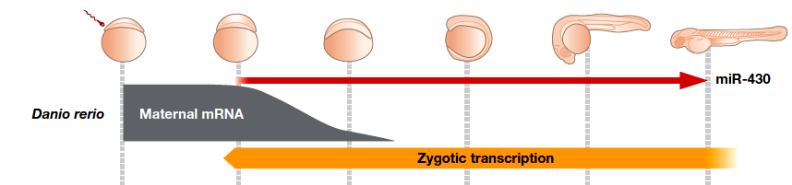
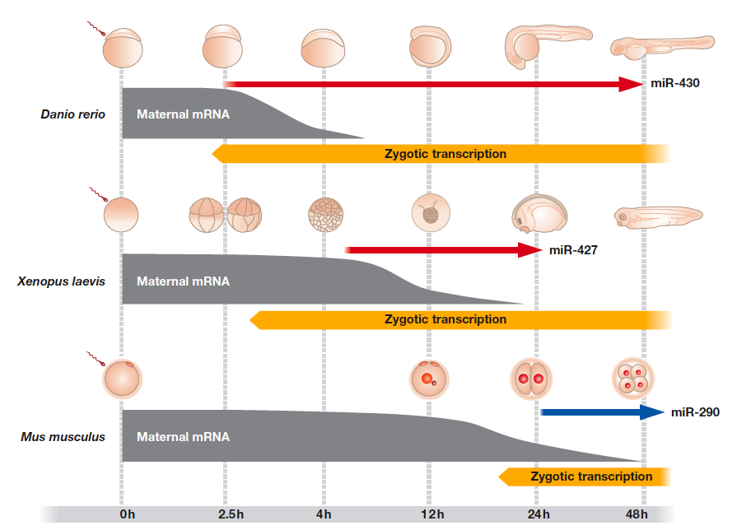
Zygotic Transition in Animals
Zygotic genome is not transcribed for several cell divisions
Zebrafish
Cleavage cycle:1 8 12 >14
(256 cells)
Svoboda & Flemr EMBO Reports 2010
Zygotic Genome Activation (ZGA) is delayed

Slide 9
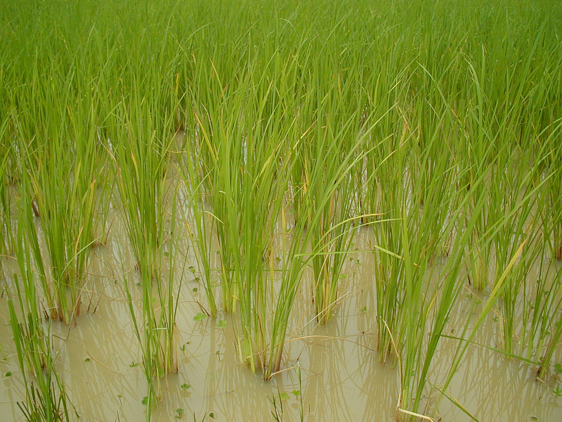
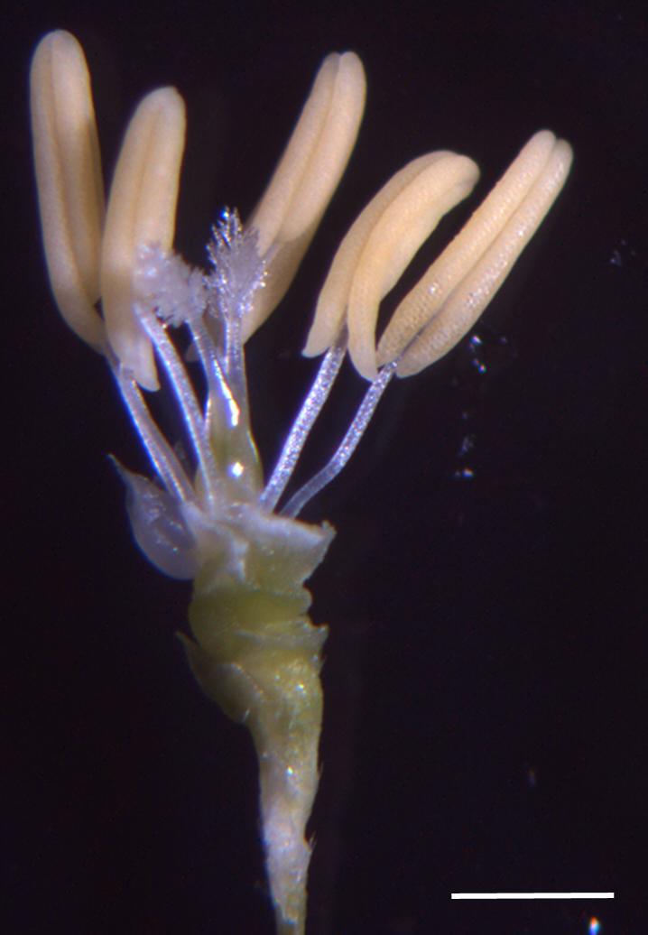
Rice as a model for plant zygotes
Rice has one of the fastest times from pollination to fertilization amongst flowering plants: 30 minutes!
(vs. > 6h Arabidopsis, >8h maize)
-> Isolation of living time-staged zygotes is feasible

Slide 10
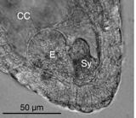
Isolation of living zygotes from ovules
Rice ovule dissected to show embryo sac. E = Egg cell, S = Synergid, CC = Central Cell
From Scott Russell, U. Oklahoma (Collaborator)
0 HAP
Unfertilized Egg Cell
1HAP
Fertilized Egg Cell
Plasmogamy- Fusion of sperm and egg cell
2.5 HAP
Zygote
Karyogamy- Nuclear fusion
(Images: DIC and uptake of dye FDA)
Anderson et al. 2017 Developmental Cell

Slide 11
Stages of rice zygote development can be accurately timed and collected
Summary of time course for fertilization and zygotic development in rice (hap = hours after pollination)
0.5 hap
Pollen Tube
Reaches ovule
1 hap
Plasmogamy
2 hap
Karyogamy
2.5 hap
5 hap
Egg and
Sperm
Nucleoli
Fuse
9 hap
Late G2
12 hap
Two Cell
Pro-Embryo
E
Sy
Sy
S
S
Z
Z
Z
Z
Z

Slide 12
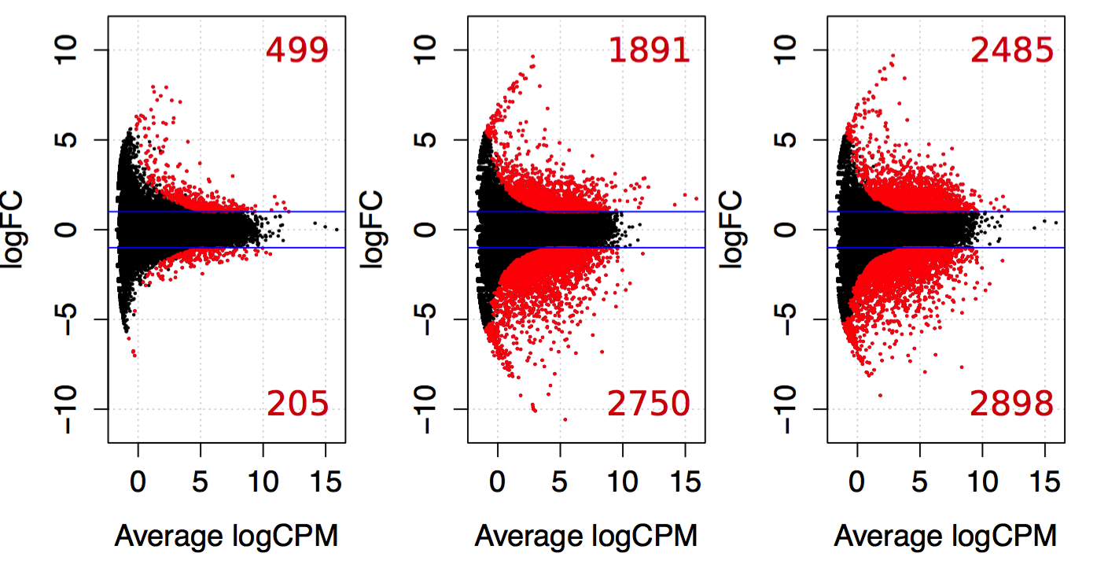
Zygotic transcription initiated at karyogamy (G1 phase), a burst of activation during S phase
2.5h Zygote
Karyogamy
5h Zygote
nucleolar fusion
9h Zygote
Late G2
Compare Human embryos:
1399 up
1752 down
DE genes at the 8-cell stage (Xue et al. Nature 2013)
Up
Up
Up
Down
Down
Down
# DE genes Up: 499 1891 2485
# DE genes Down: 205 2750 2898
Anderson et al. 2017 Developmental Cell

Slide 13
Zygotic Genome Activation occurs before the first embryonic division in multiple flowering plants
Rice - Anderson et al. 2017 Developmental Cell
Maize – Chen et al. 2017 The Plant Cell
Arabidopsis – Zhao et al. 2019 Developmental Cell

Slide 14
Rice: Gene clusters with similar expression dynamics
Egg cell
TFs down
regulated
Embryogenic
TFs
up-regulated
DNA replication
Factors
Histones
Anderson et al., 2017

Slide 15
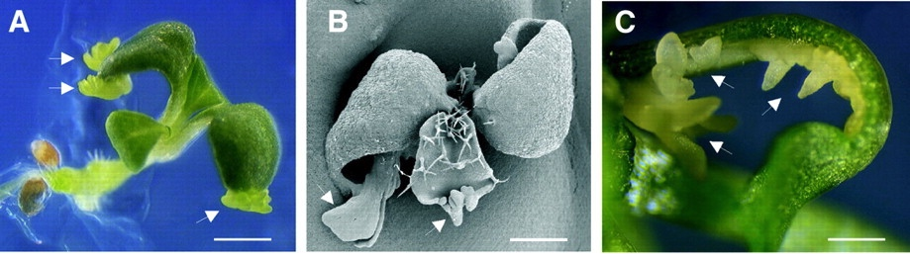
Transcription factors expressed de novo in zygotes at 2.5 HAP (karyogamy) and 5 HAP (S phase)
  Baby Boom (BBM)
Ortholog in Arabidopsis:
Promote somatic embryogenesis
Boutilier et al. Plant Cell 2002;14:1737-1749
-WOX8/9 and WOX2: WUSCHEL-like Homeodomain
(orthologs in Arabidopsis required for embryogenesis)
-LEC1: LEAFY COTYLEDON 1
Orthologs in Arabidopsis promote somatic embryogenesis
- E2F family TFs: Promote S phase progression in eukaryotes

Slide 16
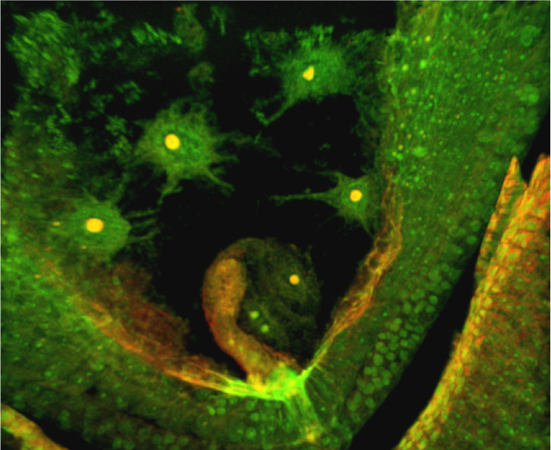
Chronology of TFs in rice zygotes
14 hap
First embryo division
5 hap
G1/S
Zygote polarity
2.5 hap
G1 phase
WOX2
LEC1
BBM/PLT
genes
WOX8/9
E2F
family
DNA Replication
S phase progression
Rice pro-embryo 14 hap
(Image: Daniel Jones, U. Oklahoma)

Slide 17
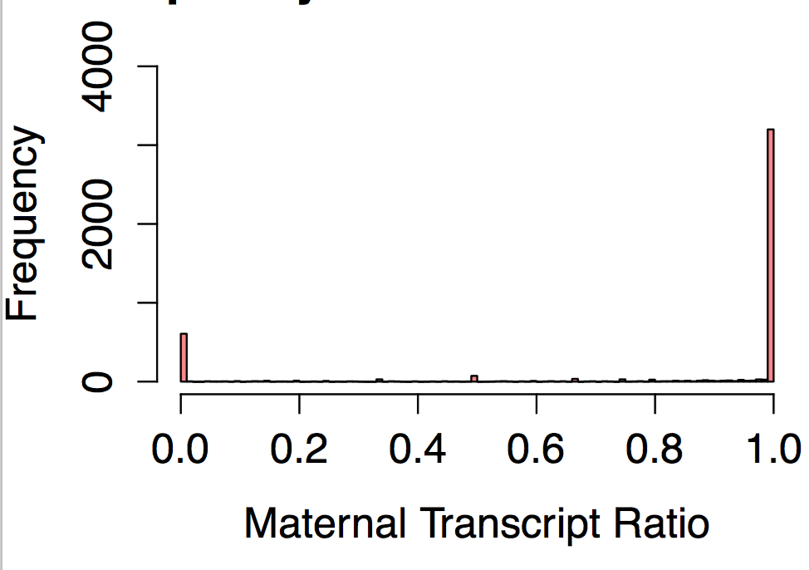
Newly expressed genes are mainly from Maternal genome. Paternal genome is silent. But some exceptions
Do the two parental genomes contribute equally to de novo transcripts in the Zygote?
P
M
Parent-of-origin assigned using SNPs: 4431 genes with 0 reads in Japonica egg and expression in 2.5h J♀ X I♂ zygotes
X axis: Ratio of maternal transcripts to total transcripts
R = 1.0 => Maternal allele only
R = 0.5 => Equiparental expression
R = 0.0 => Paternal allele only
Anderson et al. 2017 Developmental Cell

Slide 18
Some de novo Transcription factors show early paternal expression (at karyogamy)
  Baby Boom (BBM)-like genes OsBBM1-4
Boutilier et al. Plant Cell 2002;14:1737-1749
Sperm cell
expression
+
-
+ low
+ low
OsBBM1
OsBBM2
OsBBM3
OsBBM4
= Paternal expression
= Paternal expression
Undetermined
Undetermined
(insufficient reads across SNPs)
(transciptome data: Anderson et al. 2013 Plant J.)

Slide 19
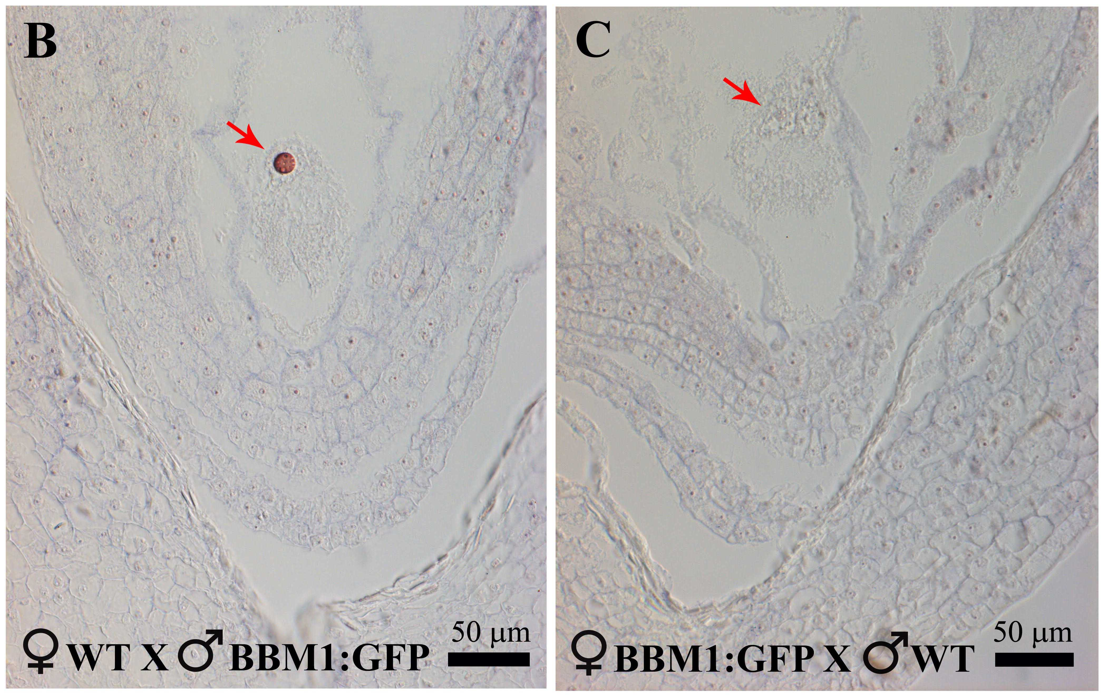
Paternal-allele specific expression of OsBBM1 in isogenic rice zygotes after fertilization
OsBBM1-GFP from ♂ is expressed
OsBBM1-GFP from ♀ is silent
BBM1:GFP-H2B expression in zygote nuclei of japonica rice at 2.5 hours after pollination (HAP) by antibody labelling
Khanday et al, 2018 Nature

Slide 20
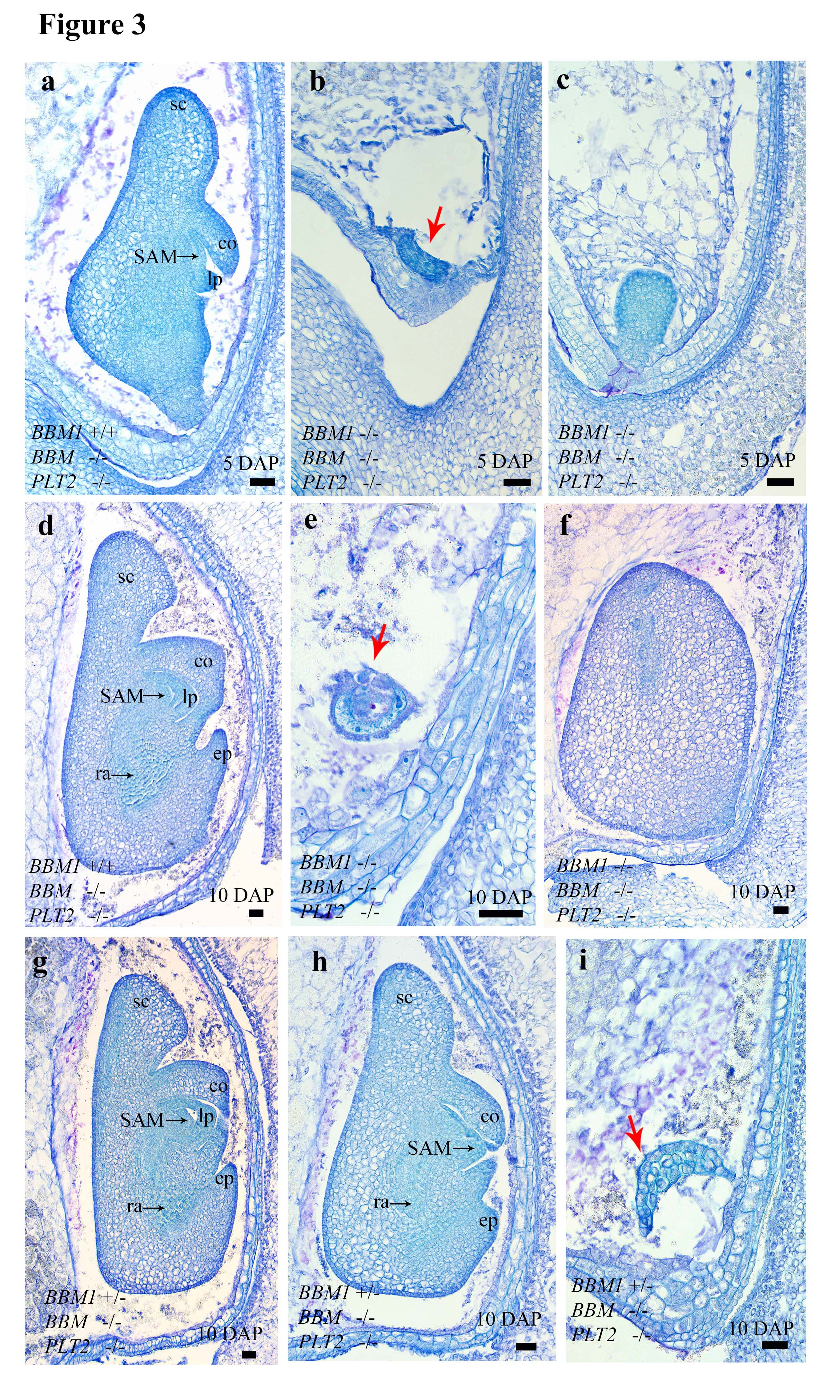
bbm1-3 triple mutants are embryo defective. Fully rescued by male BBM1 But not by female BBM1
Heterozygous embryos: Maternal BBM1 functional allele + Paternal bbm1 mutant allele
Show defective growth and arrest
WT embryo
BBM1 ♀/bbm1 ♂
Arrested embryo
Khanday et al, 2018 Nature

Slide 21


Model: Embryogenesis is triggered by transcription factors expressed from the male genome
Egg Cell
ZYGOTE (2N)
No mRNA OsBBM1
Egg
No mRNA OsBBM1
Fertilization
Embryo
OsBBM1 is expressed in Sperm Cells
Sperm Cell
OsBBM1 mRNA paternal allele
mRNA OsBBM1
Sperm cells

Slide 22
Can OsBBM1 induce embryogenesis if we express the gene ectopically in the Egg cell?
No mRNA OsBBM1
Egg Cell (1N)
Embryo (1N)
development
without fertilization?
Transgene pEggCell::
OsBBM1
Experiment
Transgenic plants with Egg Cell promoter::OsBBM1 fusion

Slide 23
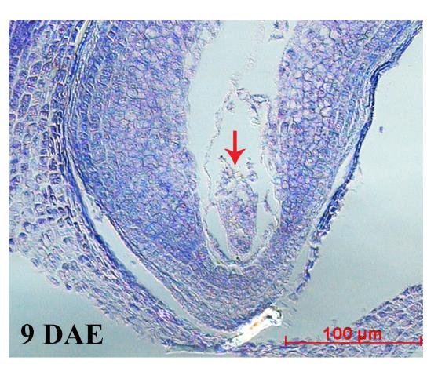
Result: Parthenogenesis
Haploid embryo
Flowers emasculated:
Embryo without fertilization
(No endosperm)
Khanday et al. 2018 Nature

Slide 24
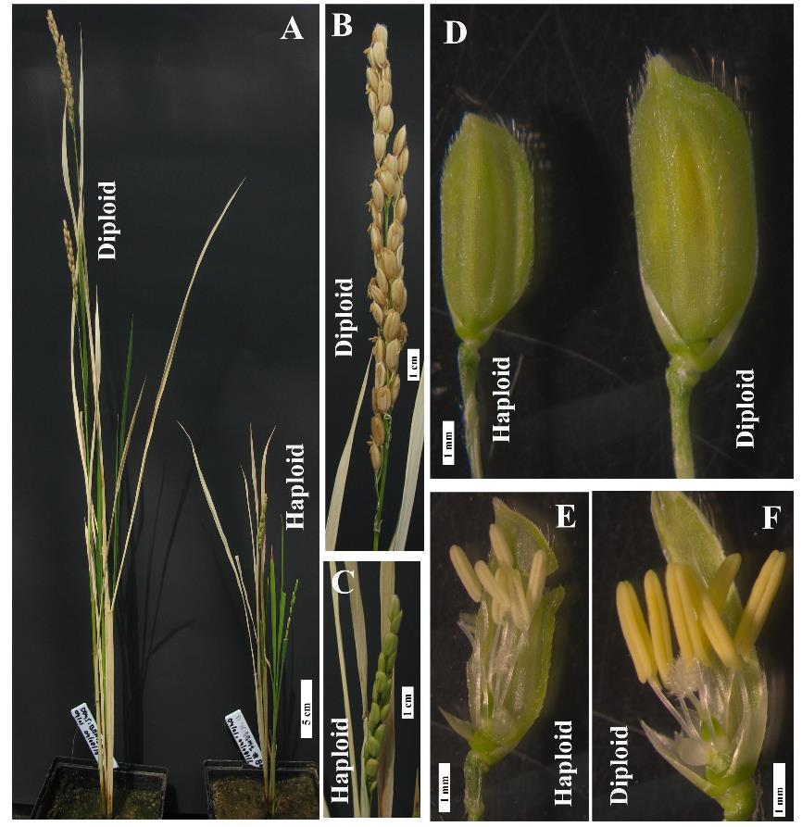
Ectopic expression of OsBBM1 in the Egg cell: Parthenogenesis
Without emasculation: get Haploid plants
Fertilization of Central Cell leads to endosperm formation and viable seeds
Haploid plants
Smaller than Diploids
Shorter panicles
Sterile flowers
Khanday et al. 2018 Nature

Slide 25
Express OsBBM1 in the Egg cell
Result: Bypass fertilization of egg ->Parthenogenesis
No mRNA OsBBM1
Egg Cell (1N)
Embryo (1N)
develops
without fertilization
Transgene pEggCell::
OsBBM1
Embryo from female only (no male needed)
“virgin birth” induced in a sexual plant

Slide 26
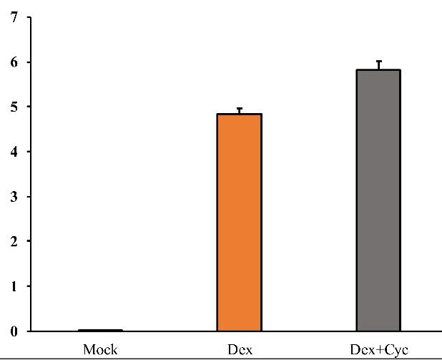
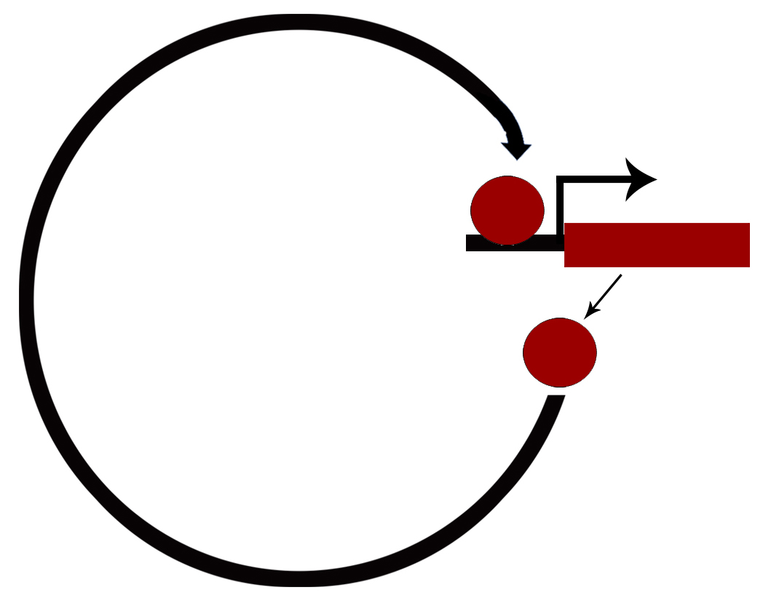
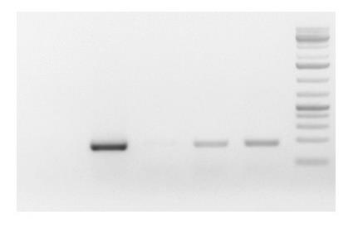
BBM1 Activates its Own Expression
BBM1 endogenous transcript
in Seedlings (2 week old)
Dex-inducible gene expression system
in seedlings
GR
Log₂ Fold Change
BBM1
BBM1
Mock DEX DEX
+ CYC
NO DNA
Dex I
Calli cDNA
Mock I
Dex+Cyc I
BBM1
Auto-activation
of BBM1
BBM1
BBM1
PCR of BBM1 endogenous transcript

Slide 27
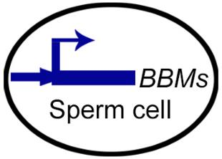
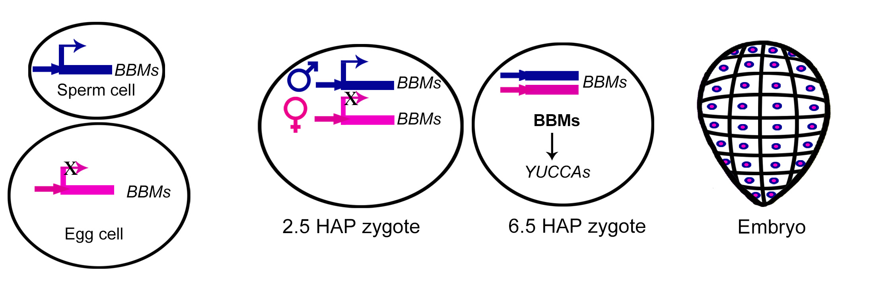
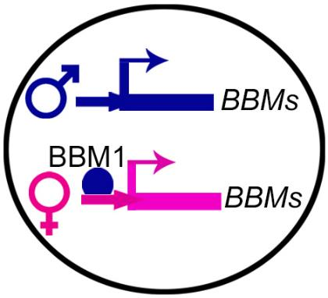
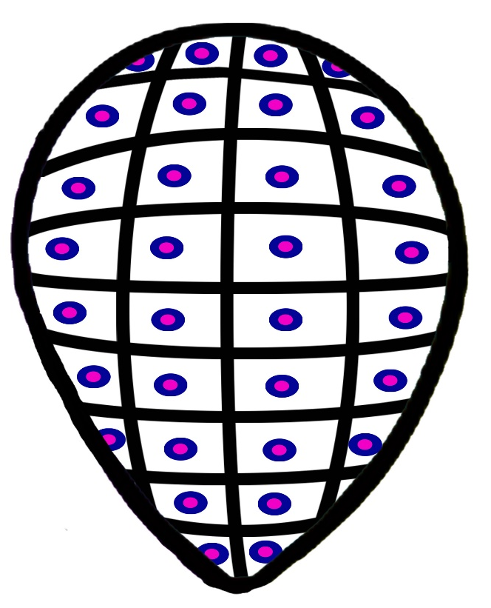
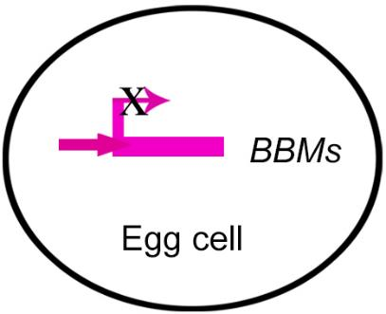
Sequential activation of BBM1 alleles in Zygotes
active
2.5.HAP
G1 (karyogamy)
5-9 HAP
S – G2 phases
Fertilization
Embryo
♂ allele
expressed
Both alleles
expressed
Due to
auto-activation
silenced

Slide 28
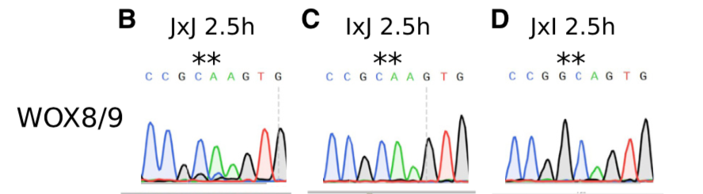
Parthenogenesis induction by BBM1 is incomplete
Only 5%-29% (% of progeny that are haploid)
Are we missing other factors that may participate in the zygotic transition?
Re-examine Zygote transcriptome: Parent-of-origin datasets
WOX9 transcription factor is also expressed only from the male genome at the early stages (2.5h, after karyogamy)
Anderson et al. 2017 Developmental Cell
WOX genes: WUSCHEL-like Homeobox gene family
Founding member WUSCHEL required for shoot meristem specification
In Arabidopsis, WOX2, WOX8, WOX9 required for normal embryogenesis

Slide 29
BBM1 in egg cell: Parthenogenesis induction frequency 5%-29%
Experiment: Co-express WOX9 + BBM1 in the egg cell
OsBBM1
OsDWT1
Not expressed
Egg Cell (1N)
+
Embryo (1N)
develops
without fertilization
Transgenes pEC::BBM1
+
pEC::WOX9
BBM1 + WOX9 result: Parthenogenesis frequency reaches 85-90%!
NOTE: Expression of WOX9 alone does not result in Parthenogenesis:
Therefore WOX9 functions as an enhancer of BBM1

Slide 30
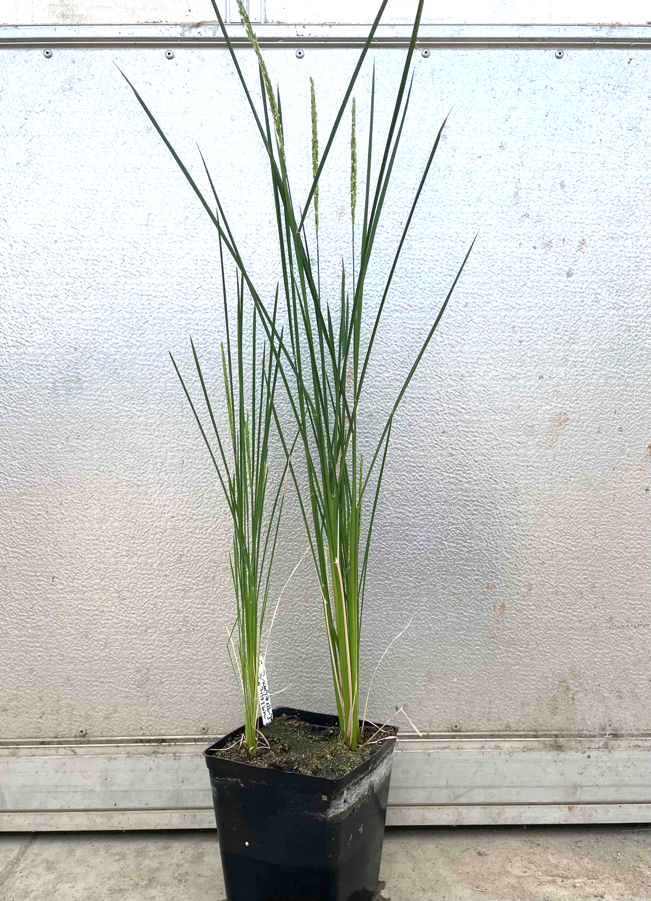
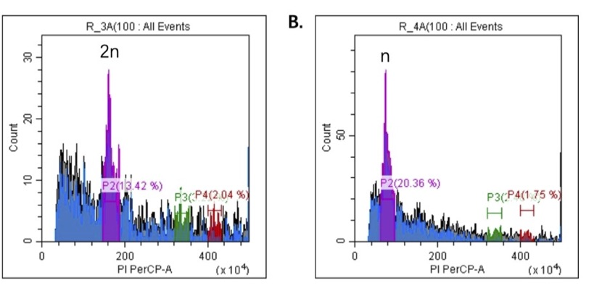
Male genome-expressed transcription factors BBM1 and WOX9 synergistically promote egg cell to zygote transition
Parthenogenesis → Haploids
Plants are small and sterile
Parthenogenic
Haploid
BBM1 + WOX9
Haploids confirmed by Flow Cytometry
Sexual Diploid
Sexual Diploid
Parthenogenic
Haploid
BBM1 + WOX9

Slide 31
Model: Embryogenesis is triggered by BBM and WOX transcription factors expressed from the male genome
Egg Cell
No BBM1 mRNA
ZYGOTE (2N)
Egg
No WOX9 mRNA
No BBM1 mRNA
Fertilization
No WOX9 mRNA
Embryo
Sperm Cells
Sperm Cell
BBM1 mRNA paternal allele
BBM1 mRNA
WOX9 mRNA paternal allele
No WOX9 mRNA
OsBBM1 expression

Slide 32
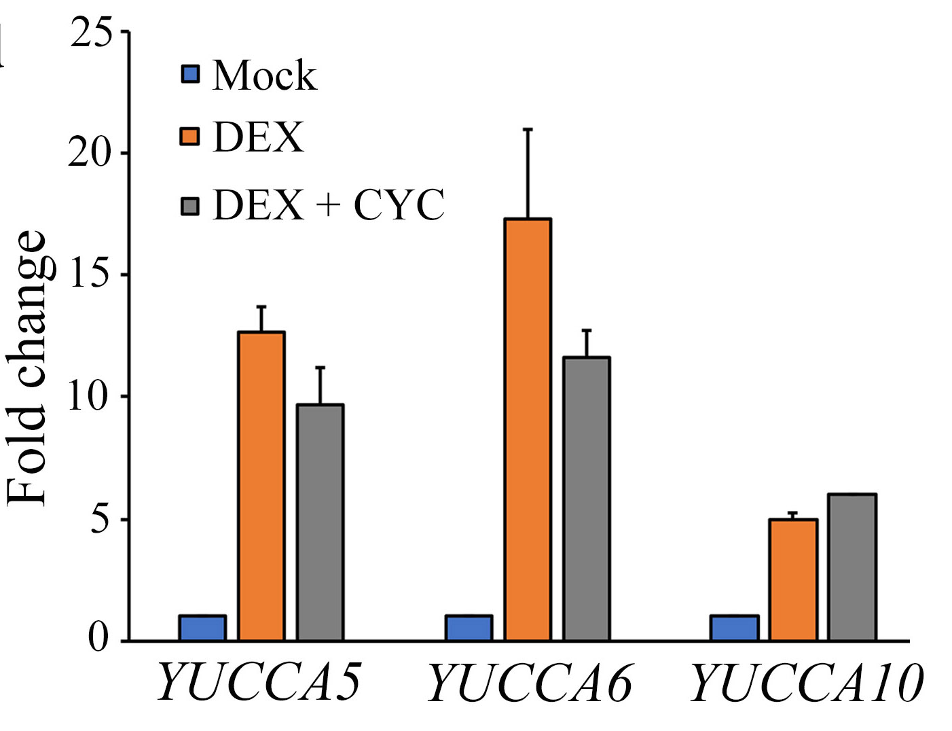
BBM1 downstream targets: DEX-induction in seedlings
Dex-inducible gene expression system
6 h Dex induction in leaves of 2 week BBM1-GR seedlings
GR
BBM1
Target Gene
Induction of YUCCA 5, 6, 10 genes by BBM1-GR + DEX
YUCCA genes encode flavin monooxygenases for Auxin biosynthesis
Khanday et al. 2022 BioRxiv

Slide 33
Interaction of Male and Female genomes in Embryo initiation
+
BBM1
WOX9
YUCCA
S-phase genes
?
Auxin
Cell division
Zygote (after karyogamy)
Embryo
Male-genome expressed Transcription Factors activate Female-genome expressed genes
=> Cellular processes including auxin synthesis that initiate embryo development

Slide 34
Zygotic Genome Activation (ZGA):
From Fertilized Egg to One-cell Zygote
Questions:
Why is the ♂ genome mostly silent in the zygote, while ♀ genome is expressed?
Why are BBM and WOX transcription factors expressed only from the ♂ genome?
Different epigenetic modifications of of ♂ and ♀ genomes before fertilization
Approaches:
Small RNA transcriptomes (Egg cell, Sperm cell, Zygotes)
Methylome sequencing of gametes & zygotes

Slide 35
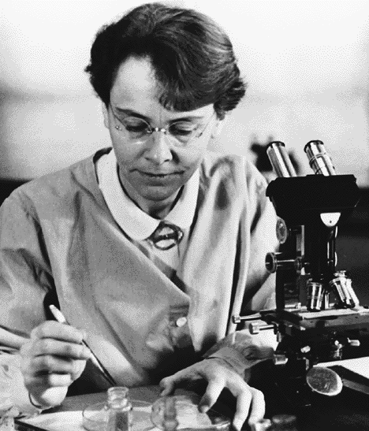
Re-programming of the genome in the germline
Barbara McClintock, plant geneticist
Nobel address 1983
The significance of responses of the genome to challenge:
“In higher plants, each fertile flower has the equivalent of a “germline” in it. The flower makes the gametes and initiates embryo formation…. Some system must operate to reprogram the genome in those cells of the flower that will produce the gametes and establish the zygote.”

Slide 36
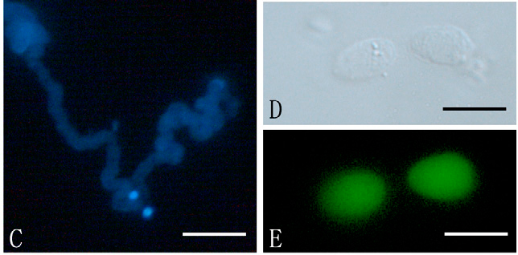
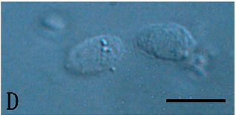

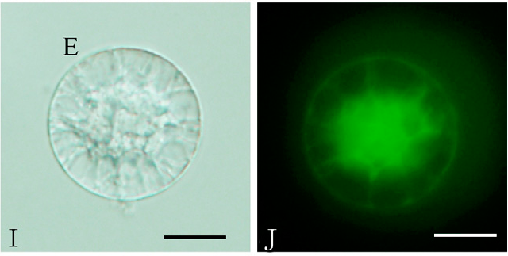
Gametes: Sperm Cells and Egg Cells
Pollen tube with
2 Sperm cells
(Arrows: nuclei w. DAPI)
Isolated Sperm cells
10 um
Sperm cells
(Living cells shown by uptake of dye FDA)
50 um
10 um
10 um
Embryo sac containing
Egg Cell (E)
Isolated Egg Cell (E)
Egg cell
10 um

Slide 37
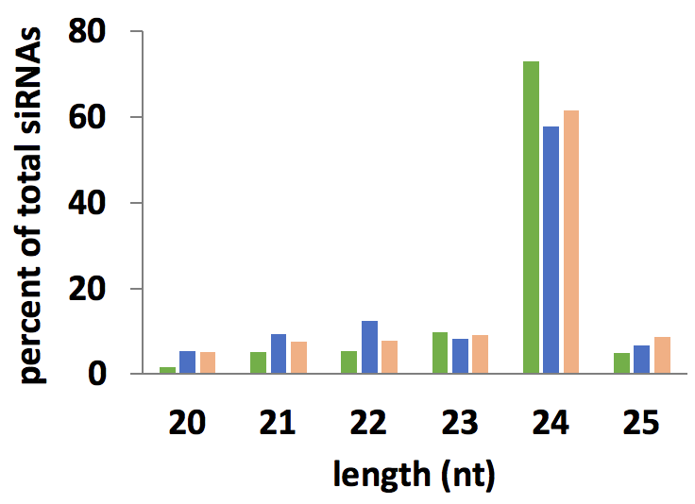
24nt small RNAs are the dominant length across cell types
Li et al 2020 Genome Research
Notes:
24nt small RNAs guide DNA methylation
Where are they in the genome? What sorts of genetic elements produce them?

Slide 38
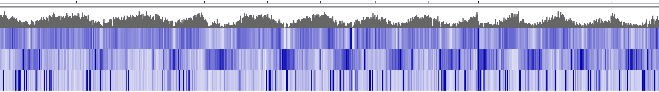
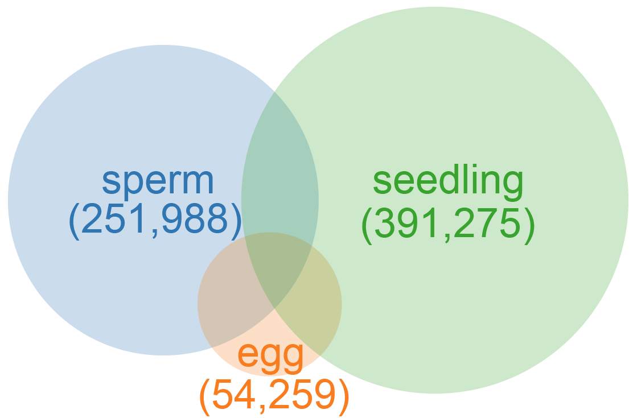
Genome-wide reprogramming of 24nt siRNAs in gametes
chromosome
1 | 2 | 3 | 4 | 5 | 6 | 7 | 8 | 9 | 10 | 11 | 12
gene density
seedling
sperm
egg
24nt siRNAs
Number and overlap of 24nt siRNA loci in gametes and seedlings
Li et al 2020 Genome Research

Slide 39
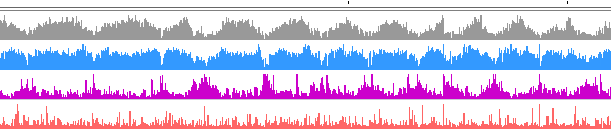
Genome view: Reprogramming of 24nt siRNA transcriptome in Gametes
1 2 3 4 5 6 7 8 9 10 11 12
Gene Density
High in Gene-rich regions
Seedling
High in Gene-poor regions including Centromeres
Sperm Cell
Egg Cell
Scarce but discrete
Peaks in Centromeres
24 nt siRNAs in Sperm Cells is the exact opposite of Vegetative tissues /Seedlings
24nt siRNAs in Egg Cells have a relatively sparse distribution vs. Sperm Cell or Seedling
Li et al 2020 Genome Research

Slide 40
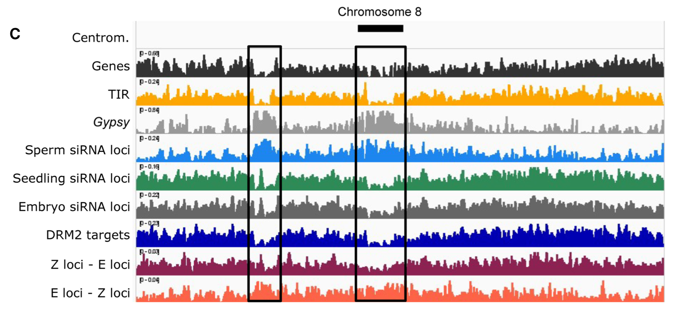
Re-setting of the siRNA transcriptome in Zygotes:
New siRNAs return to somatic profile => predictive of embryo mCHH
Zygote
specific
Egg
specific
Li et al 2022 Genome Research

Slide 41
Applications
Synthetic apomixis: Clonal propagation of crops through seeds

Slide 42
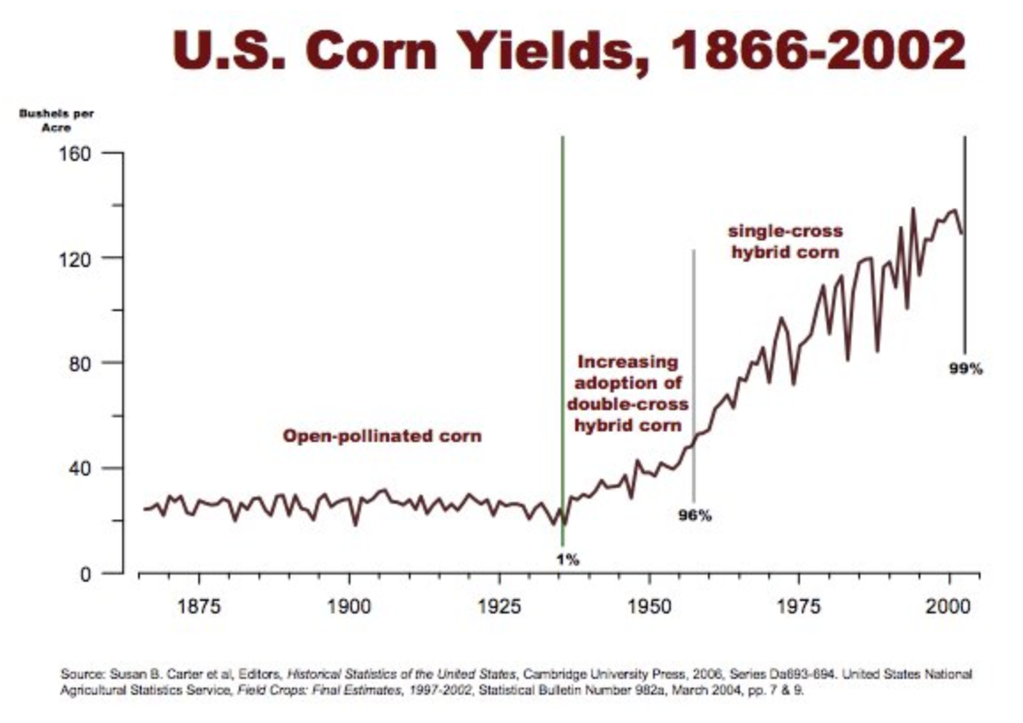
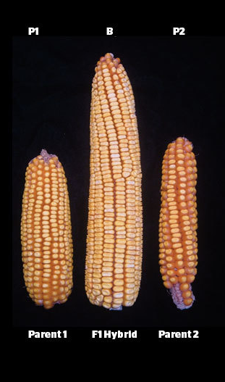
The Hybrid Revolution in Agriculture
Hybrid Seed Revolution 1920s
www.agrihunt.com

Slide 43
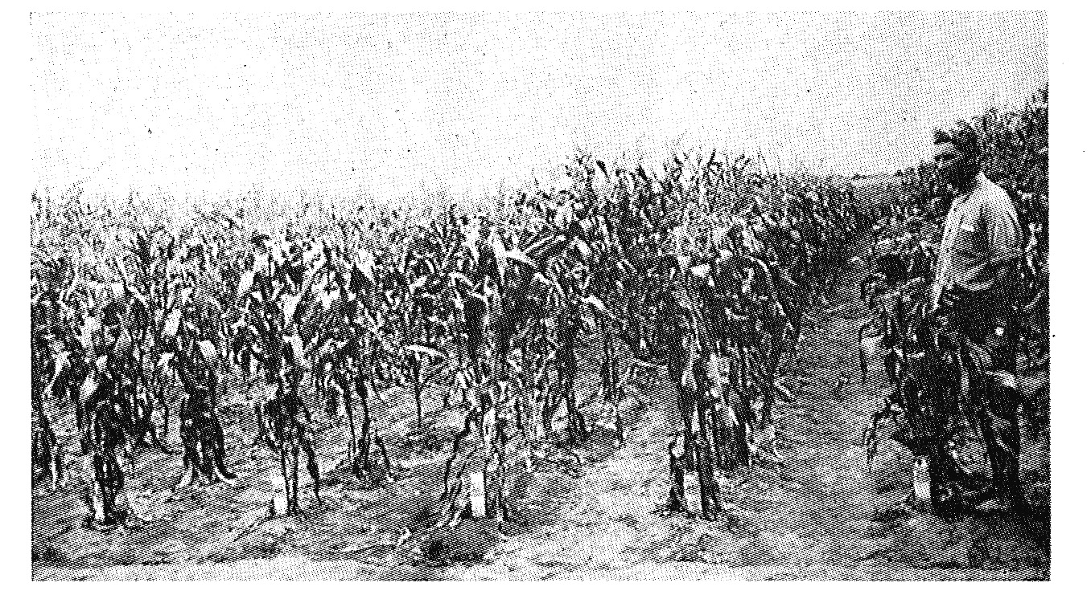
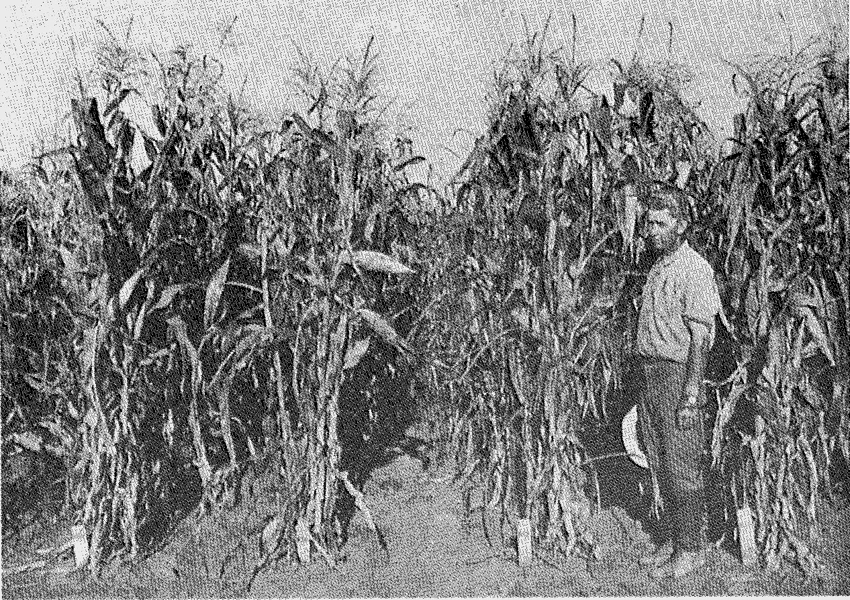
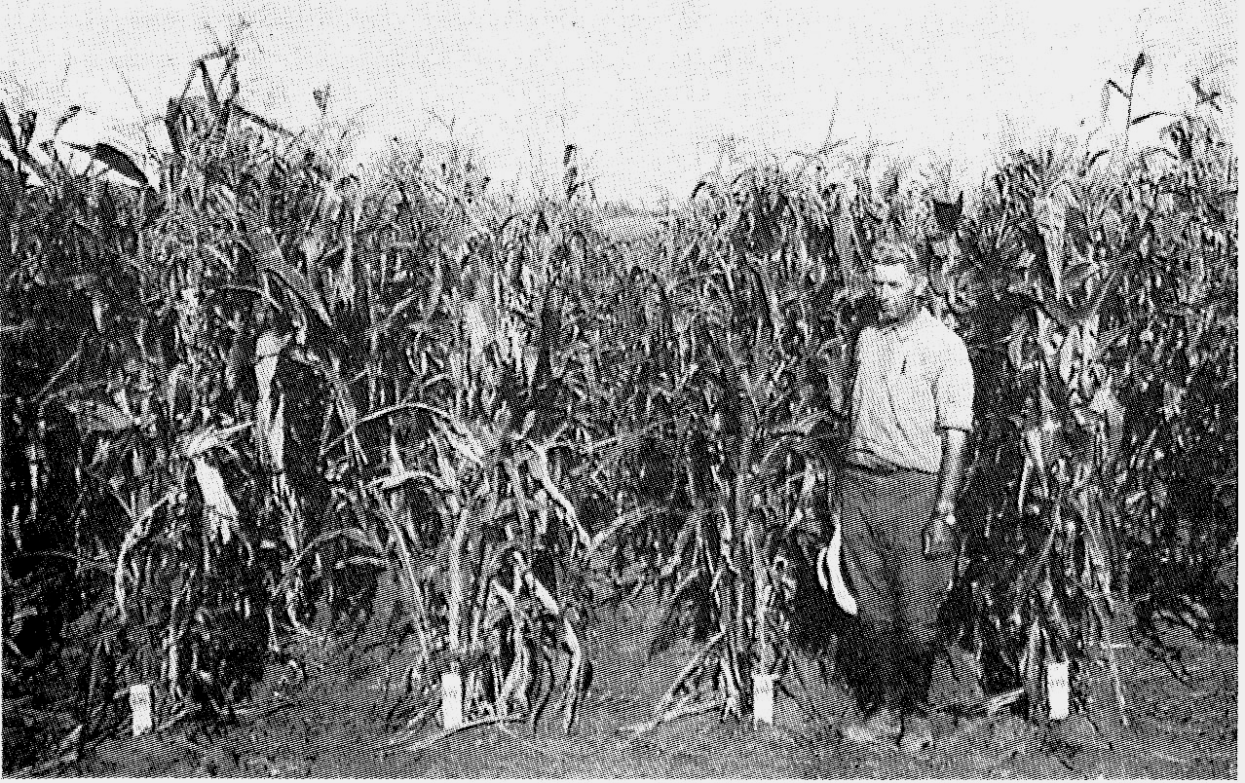
The Hybrid Seed Revolution: An experiment with maize c.~1920s
Inbred parental
Lines (F0)
First generation Hybrids (F1)
The next generation (F2)

Slide 44
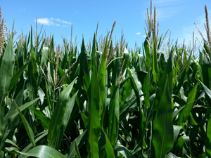
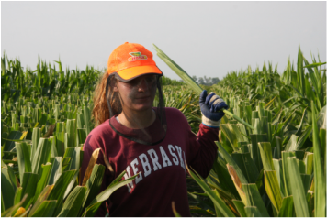
Hybrid Corn: De-tasseling to prevent self-fertilization
Summer jobs for high school students in Midwest
www.radioiowa.com
www.psdetasseling.com/

Slide 45
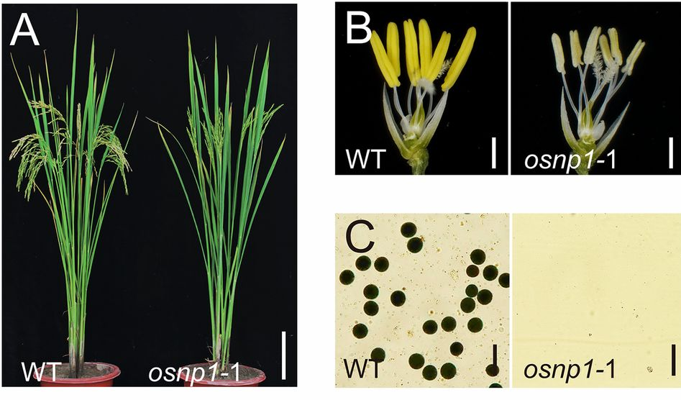
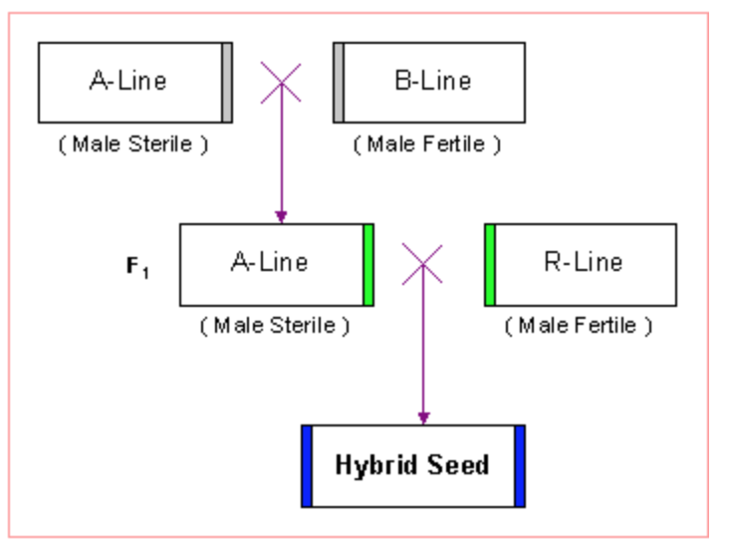
Hybrid Rice Seeds: Produced by a 3-line strategy involving male steriles and fertility restorers
Chang et al. PNAS 2016
Hybrid Rice Seeds
More expensive
Have to be purchased each year (cannot plant the progeny seed and retain high yields)

Slide 46

Most of the world’s rice farmers don’t plant hybrid rice
e.g. Hybrid rice is 5-10% of rice acreage in South & SE Asia, close to 0% in Africa
Figure 1: Spatial units covered in RiceAtlas and the number of rice-growing seasons.
Laborte et al. (2017) Scientific Data 4: 170074

Slide 47

Global Rice Production Increase Needed to Meet Demand by 2035
Mio Mt (Milled Rice)
Additional yield of hybrid rice at 1.5 tonne/ ha can help to bridge the gap
Ramlekhan Verma, ICAR

Slide 48

high yields
APOMIXIS
Asexual reproduction through seeds.
Avoids Meiosis-> Progeny are genetically identical to parent
In nature: >300 different plant species
From S. Lolle, Purdue Univeristy

Slide 49


Slide 50
Ectopic expression of OsBBM1 in the Egg cell Parthenogenesis: Haploid embryos and haploid plants
Haploid embryo
Flowers emasculated:
Embryo without Endosperm
Fertilization to get Endosperm: Viable seeds with Haploid embryos and Triploid Endosperm
Seeds produce Haploid plants
Khanday et al. 2018 Nature

Slide 51


Poster
Daphne Mieulet & Emmanuel Guiderdoni (CIRAD) and Raphael Mercier (INRA)
A combination of 3 meiotic mutants: osd1 pair1 rec8
to get MiMe (Mitosis instead of Meiosis) in rice
MiMe plants make unrecombined diploid gametes
i.e., 2N egg cell and 2N sperm cells
(Mieulet et al. Cell Reports 2016)

Slide 52
Knockout of three genes (pair1, rec8 and osd1) results in MiMe (Mitosis instead of Meiosis)
Mieulet et al. Cell Reports 2016

Slide 53
CRISPR-Cas9 for OSD1, REC8, PAIR1
+ BBM1-ee (egg cell expression) transgene
→ Obtained MiMe + BBM1-ee transformants
DIPLOID
+BBM1-ee
Egg Cell
TETRAPLOID
Progeny of these plants will be
Tetraploid if Sexual
Diploid if Asexual (Clonal)

Slide 54
And it works….
The First
Clone
Khanday et al, 2019 Nature

Slide 55
Clones were confirmed for heterozygosity by whole genome sequencing
The apomictic trait is heritable with no obvious phenotypic changes:
a. Diploid clones produced diploid ”grand clones”
b. Diploid grand clones produce ”great grand clones”
c. And so on-> 8 generations now -> ad infinitum?

Slide 56

Eight generations of asexual Clones: no apparent phenotypic changes
Sexually propagated plant
8th generation
apomictic
plant

Slide 57


Synthetic Apomixis in a commercial Hybrid Rice (BRS-CIRAD 302)
T1 Apomictic progeny
Progeny of apomictic hybrids: No segregation; Uniform traits
Sexual progeny of hybrids: Segregation of traits
Surprisingly, we observed frequencies of apomixis of up to 95% (percentage of seeds that were asexual / clonal)!
Vernet et al. 2022 BioRxiv

Slide 58
Synthetic Apomixis in a commercial Hybrid Rice (BRS-CIRAD 302)
Frequency of apomixis of up to 95% or higher, vs. previous best freq. of 29% in inbred
T1 Apomictic progeny
To transform commercial rice hybrid: A combination BBM1 + MiMe construct was used
p35S
pZmUbi
pU6
BBM1
pEC1.2
It remains unclear why the combination “all-in-one” BBM1 + MiMe construct leads to such high apomixis efficiency
Could be interactions between strong enhancers and the pEC1.2 Egg Cell promoter driving BBM1?
Vernet et al. 2022 BioRxiv

Slide 59

Making fertile inter-subspecies hybrids
indica-japonica rice hybrids exhibit strong heterosis but high sterility
However, synthetic apomicts of indica-japonica hybrids are fertile
Fertility of apomictic Indica-Japonica hybrids
Fertility of sexual Indica-Japonica hybrids
From Emmanuel Guiderdoni (CIRAD)

Slide 60
Synthetic apomixis can be used to make fertile & vigourous inter-subspecies hybrids in rice (e.g. indica X japonica)
Can apomixis be used to propagate other plants with genome combinations that are usually infertile due to meiosis?
Examples of future possibilities:
Fertile triploid plants (in progress with rice)
Inter-species crosses e.g. wild rice x domesticated rice, sugarcane hybrids, wheat x rye crosses, etc.

Slide 61









Former & current lab members & co-PIs involved
Sarah Anderson
Chenxin Li
Imtiyaz Khanday
Hui Ren
Jonathan Gent
Debra Skinner
Scott Russell
Cameron Johnson

Slide 62

Acknowledgements
Zygotes
Sarah Anderson
Cameron Johnson
Chenxin Li
Imtiyaz Khanday
Liza Conrad
Co-PIs on NSF grant
Univ. of Oklahoma:
Scott Russell
Univ. of Georgia:
Jonathan Gent
Funding
NSF PGRP
IGI Berkeley
France-Berkeley Fund
Synthetic Apomixis
Imtiyaz Khanday
Debra Skinner
Collaborators
Emmanuel Guiderdoni
CIRAD, France
Raphael Mercier
MPI-Cologne, Germany

Slide 63

University of California-Davis
Rice Experiment Station
http://sundarlab.ucdavis.edu

Slide 64




University of California - Davis

Slide 65
Thank you!

